Slide 1

SoundPrints
Audio spaces that connect and inspire
Notes:
Concept Video Link: https://youtu.be/6SU2O2mg55s

Slide 2
Problem
Solution
Achieving goals and building great habits can be difficult, emotionally taxing work. The obstacles that people encounter along the way can make them feel hopeless and kill their motivation. This is especially true when they do not have a community to help motivate them and celebrate their achievements.
SoundPrints is a location-based audio journaling app that enables its users to connect with and inspire one another. When at a given location, users can gain inspiration and encouragement to achieve their goals by listening to the audio recordings left by others who visited that location. By adding their own audio recordings, users can celebrate their successes and help inspire someone who follows in their “soundprint.” We hope users will re-listen to and share their favorite audio recordings with others in their community.

Slide 3
Market Research: Token
What is Token: Token, a past CS147 project, connects photos and videos to the location they were taken in.
Similarities: Token enables users to record media (photos and videos instead of audio) and stores those recordings according to a user’s location.
Differences: Token focuses on re-living moments and nostalgia. However, SoundPrints focuses on using the audio recordings to not only connect, but also to motivate, encourage, and celebrate achievement. We believe that audio as a medium is best-suited to our focus, as users can listen to motivational, encouraging recordings while pursuing their goals.
What worked for them: Well-received and unique CS147 project.
What didn’t work: We do not have information about constructive feedback Token received during usability testing. However, it is not currently an app, and its creators never pushed the idea into the app store. Perhaps they found it difficult to implement.

Slide 4
Market Research: Journify
What is Journify: Journify is an audio journaling app in which people can record their thoughts, get live transcripts, build their timeline, and track their mood based on the audio content they create.
Similarities: SoundPrints is also an audio journaling app.
Differences: Journify focuses on creating a space for reflection and tracking moods. SoundPrints, however, is focused on enabling people to connect, inspire each other, and celebrate their successes. Unlike Journify, SoundPrints creates a community among its users by connecting all audio recordings to a location.
What worked for them: Its users find the app therapeutic, a safe space for reflection, and low effort compared to written journaling.
What didn’t work for them: Users complain about bugs in the app, such as the app crashing while recording. They also express confusion over how to use the mood tracker feature. Finally, the app has about 10K downloads, which is a sizable amount, but it is not popular.
Notes:
Journify is an audio journaling app in which people can record their thoughts on the go, get live transcripts, build their timeline, and track their mood based on the audio content they create. Our solution is focused on goals and habits rather than generic reflection and moods. In our solution, users categorize their audio journals by types of goals/habits (exercise, diet, education, career, etc.) In addition, our solution enables users to create and share podcasts from their audio journaling history to promote easier synthesis of their progress, which is not a feature that Journify has.

Slide 5
Tasks
Simple: Listen to audio recordings made at the location you’re in.
Moderate: Add your own audio recording to the set of audio recordings at your location.
Complex: Share recordings with your friends from your daily audio digest (digest of everything you’ve recorded that day).

Slide 6
Values in Design
Our core values for our product:
Giving and Receiving Motivation
Inclusion
Community
Safety
Security
Privacy

Slide 7
Values in Design: Conflicts
Inclusion
Community
Inclusion: Enabling users to freely express themselves
Security
Privacy
Safety
Inclusion: Protecting vulnerable users from negative speech, insults, and psychological harm
CONFLICT WITH
Notes:
Inclusion and Community CONFLICT WITH Security, Privacy, and Safety
Inclusion is a conflicting value within itself: enabling users to freely express themselves CONFLICTS WITH preventing vulnerable users from negative speech, insults, and psychological harm.

Slide 8
Values in Design: Addressing Conflicts
Community guidelines: Each user reads and signs community guidelines form. Pledge to be respectful towards and supportive of others in the community.
“Report a recording” and “report a user” features: Allow users to report those who make them feel unsafe. Users will be banned from the app if they don’t follow the community guidelines.
Allow users to make their recordings anonymous.
Run a hate speech detector on each recording.

Slide 9
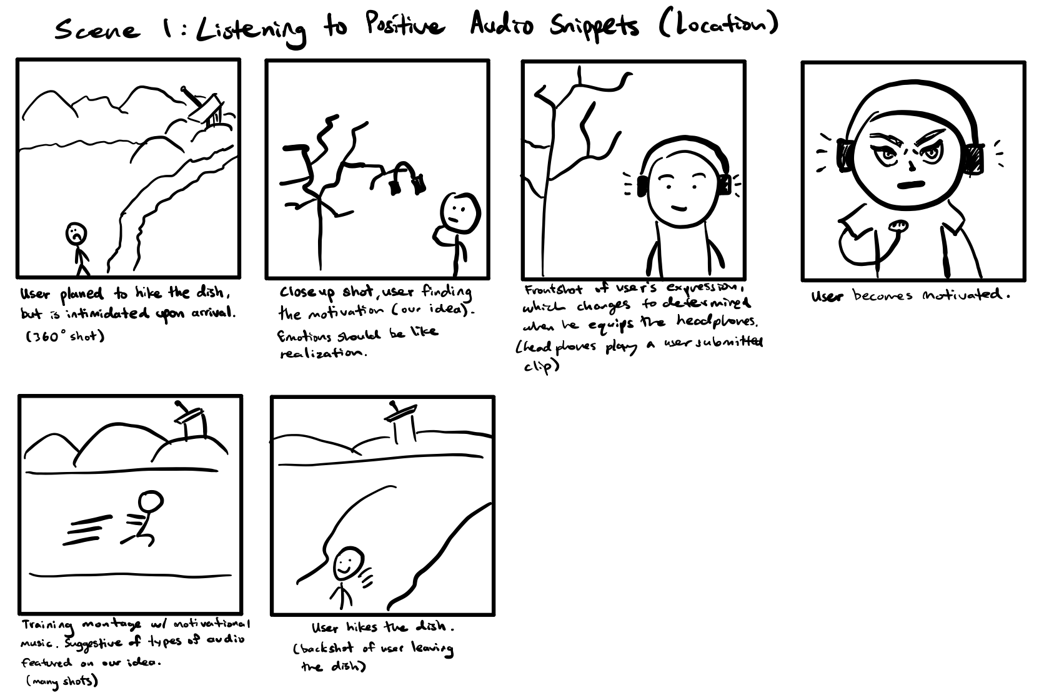
Storyboard Scene 1

Slide 10
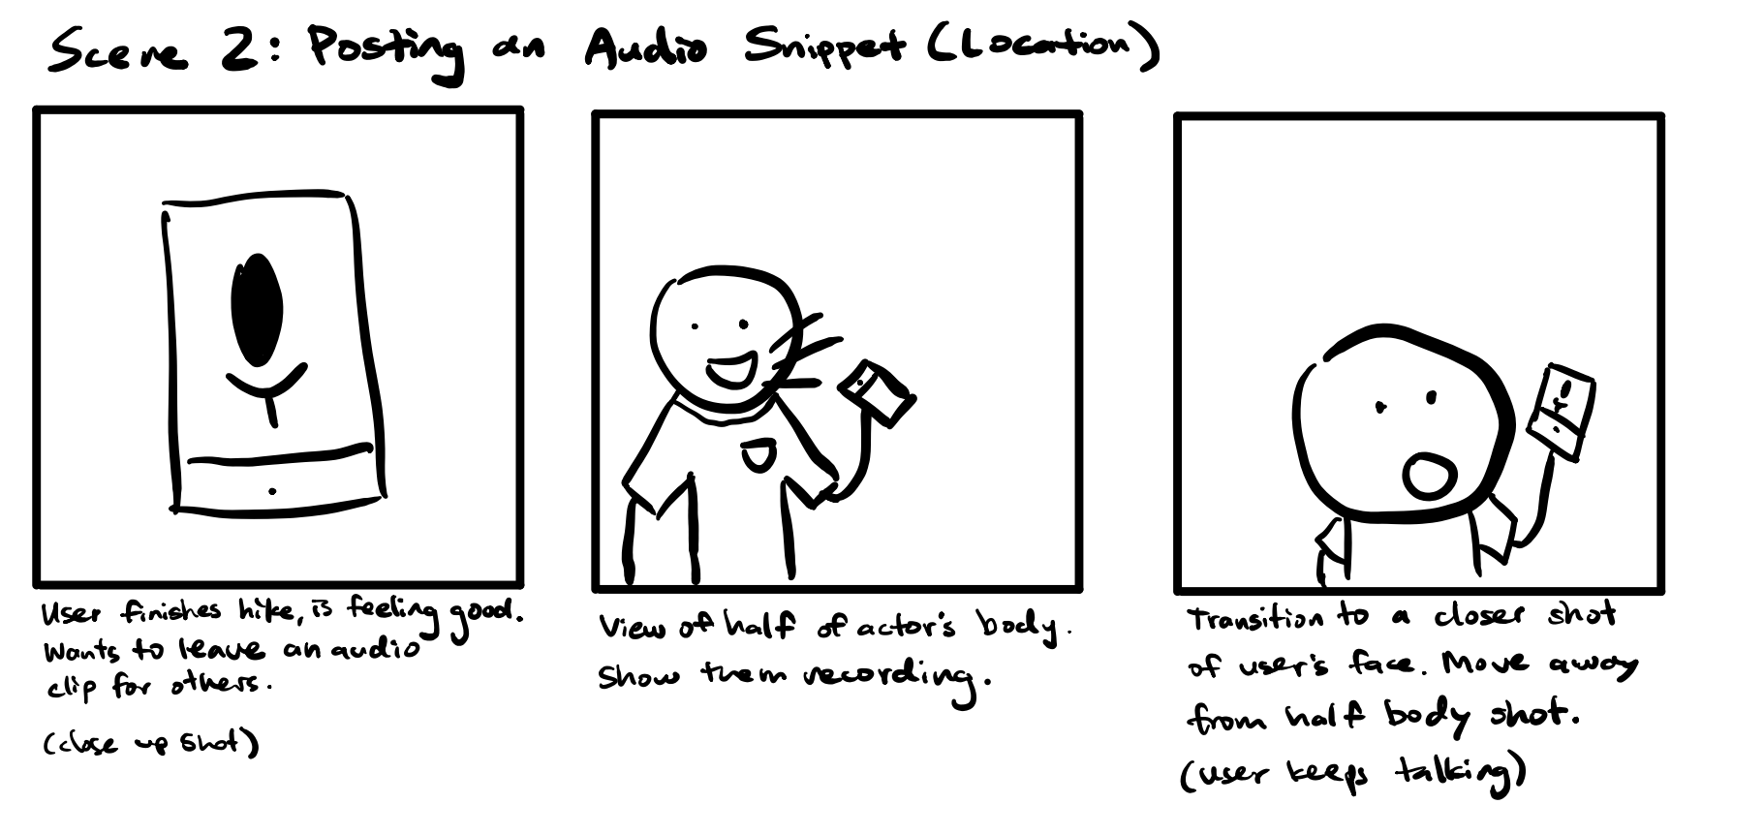
Storyboard Scene 2

Slide 11
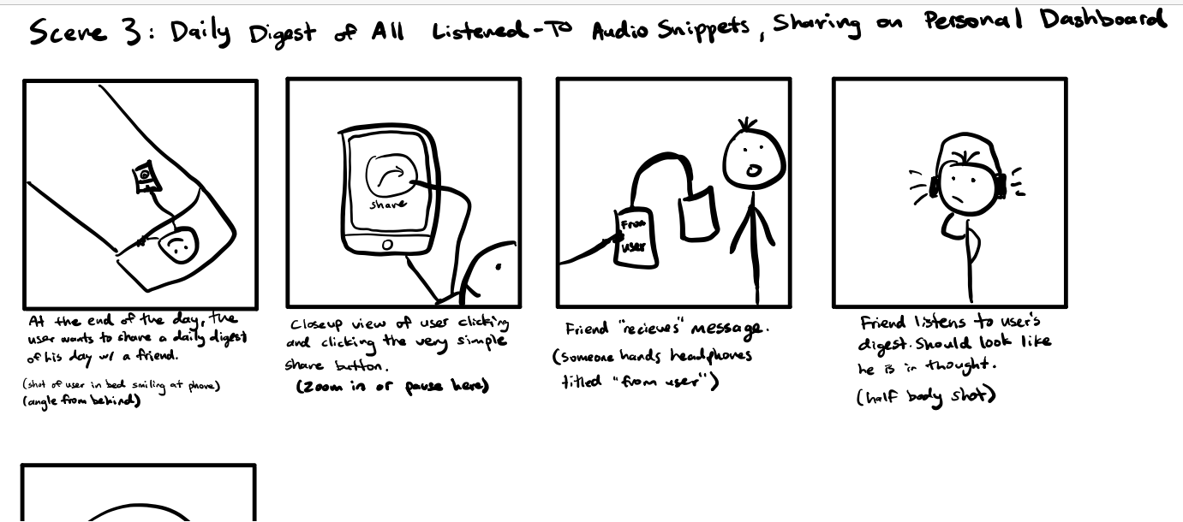
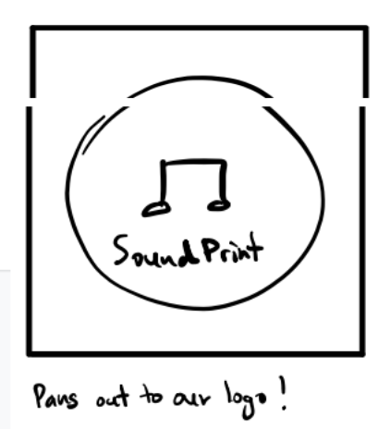
Storyboard Scene 3

